Slide 2


Gabe Maentz
Work @ RiverPointTechnology.com
Tweet @ gmaentz
Blog @ Maentz.net
Co-Founder @ vBrisket.com

Slide 3
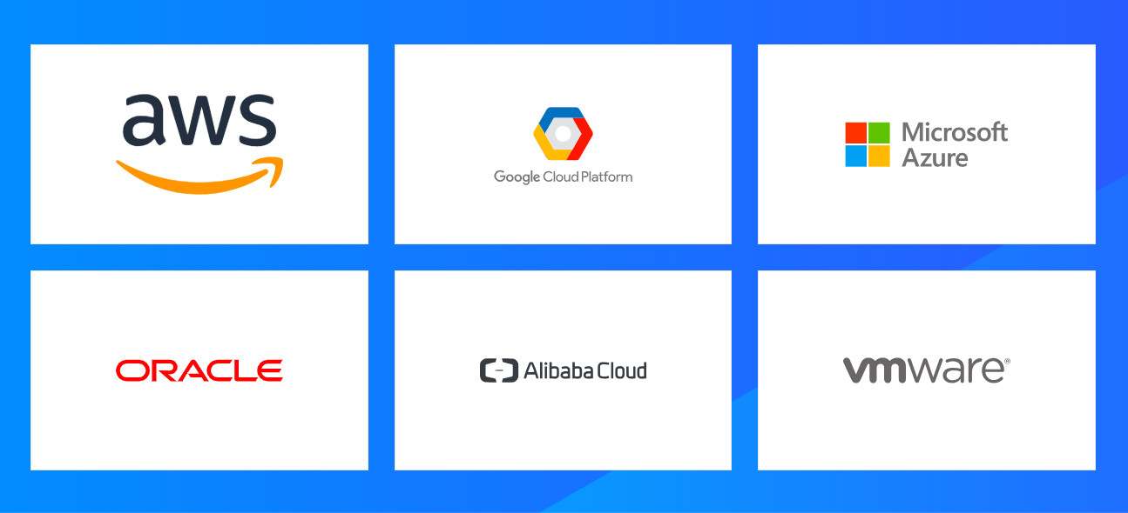
Customers are Adopting Cloud
Notes:
All major cloud providers (private and public) were present at the conference – many with new announcements in how they are integrating, and in many cases using the HashiCorp products within their ecosystem.
I know there are a number of folks in the audience utilizing VMware in their private data centers…..can I get a quick show of hands?
How about AWS users? GCP? Azure?
Oracle / Allibaba
Any not represented on this slide?

Slide 5
But the Reality is ….. Enterprises are Running Data Centers
Notes:
All major cloud providers (private and public) were present at the conference – many with new announcements in how they are integrating, and in many cases using the HashiCorp products within their ecosystem.
I know there are a number of folks in the audience utilizing VMware in their private data centers…..can I get a quick show of hands?
How about AWS users? GCP? Azure?
Oracle / Allibaba
Any not represented on this slide?

Slide 6
And those Enterprises…. are running VMware
“Most of the World is virtualized running VMware”
Andy Jassy
CEO Amazon Web Service
AWS re:Invent 2018
Keynote
Notes:
All major cloud providers (private and public) were present at the conference – many with new announcements in how they are integrating, and in many cases using the HashiCorp products within their ecosystem.
I know there are a number of folks in the audience utilizing VMware in their private data centers…..can I get a quick show of hands?
How about AWS users? GCP? Azure?
Oracle / Allibaba
Any not represented on this slide?

Slide 7
But Maybe Not That Securely
How many VM admins utilize the same root password for all of their ESXi servers?
When was the last time you updated the root password for your ESXi servers?
Do old VM admins who have left your organization still have your root passwords memorized?
Notes:
All major cloud providers (private and public) were present at the conference – many with new announcements in how they are integrating, and in many cases using the HashiCorp products within their ecosystem.
I know there are a number of folks in the audience utilizing VMware in their private data centers…..can I get a quick show of hands?
How about AWS users? GCP? Azure?
Oracle / Allibaba
Any not represented on this slide?

Slide 8
Multi-Cloud
It would really be helpful if I could use the same software and tools that I have invested all of this time and resource into to manage my infrastructure on-premises the last number of years but be able to use it to run my infrastructure on public cloud infrastructure.

Slide 9
Evolving Secrets Management
Manual
Semi-Automated Single Password
Automated Single Password
Automated Unique Passwords Safely Stored and Versioned
Manual, Use the UI to update the password
Pain Points: Time Consuming, Password is known by one admin, shares it with others
Starting to use tools like PowerCLI,
Automated PowerCLI, possibly REST API to rotate passwords
Pain Points: Password is known by one admin, shares it with others, no versioning
Automated PowerCLI, REST API to rotate passwords, unique password for all hosts, changed dynamically and still allows for manual revoke and updates
Pain Points: Password is known by one admin, shares it with others, password is updated only when administrator has time to run the script, limited versioning

Slide 10
Vault’s Pluggable Architecture
LDAP / Active Directory
Auth
(Identity)
Secrets
vCenter
ESXi Hosts
Vault
ESXi Password
(Key Value)
Audit
Splunk
ELK
Syslog

Slide 11
Manual

Slide 12
Semi-Automated Single Password

Slide 13
Automated Single Password
Host Profiles - (VMware Enterprise Plus License)

Slide 14
Automated Single Password
Esxi_password_batch_update.ps1

Slide 15
Automated Unique Passwords Safely Stored and Versioned
Read from Vault

Slide 16
Automated Unique Passwords Safely Stored and Versioned
Update Vault

